Slide 1


We Trace your Virtual Footsteps
created by-Team Traces
Andrew DeLissio
Tyrone Jenkins
Monis Masood Khan
Phillip Bailey
Vikas Piddempally

Slide 2

Overview
The Traces application intends to be an online content tracker that keeps one aware of their virtual traces - it lets the users understand what information is available online about them.
The end goal of this application is to allow a user to click a location on a map and be provided with information about the persons who have previously visited that location (and to pivot from this search to related information).

Slide 3
Objective
By witnessing the amount of information that others have unknowingly shared with perfect strangers, this app would serve as an educational tool to help users make safer decisions about what types of information to post online and what not to!
Eg: It is a bad idea to talk about going on vacation before you do so since it tells people that you are not home.

Slide 4
Inspiration
This concept is loosely based on Keith Lee's OSINT Stalker tool, but is intended to be used by normal people.

Slide 5
Technical Specification
Front End
Includes the presentation layer for display & user interface
Android Studio + ART (Android Run Time)
Google Maps API / OpenStreetMap API
Fluid UI & Adobe suite for Mock-ups & UI elements
Consume JSON API
2. Data & Server Side
For storing retrieved JSON format data and displaying on UI accordingly.
Go Programming Language
Twitter & other open ended API’s
Present JSON API
Google App Engine

Slide 6
Android Studio
Android Studio is the official IDE for Android application development, based on IntelliJ IDEA. Features include:
Flexible, Gradle-based build system
Build variants and multiple apk file generation
Code templates to help you build common app features
Rich layout editor with support for drag and drop theme editing
Lint tools to catch performance, usability, version compatibility, and other problems
ProGuard and app-signing capabilities
Built-in support for Google Cloud Platform, making it easy to integrate Google Cloud Messaging and App Engine

Slide 7
Minimum Functionality
Basic integration with Twitter’s API
Attractive and useful visualization of data

Slide 8
Desired Target
Non-technical users

Slide 9
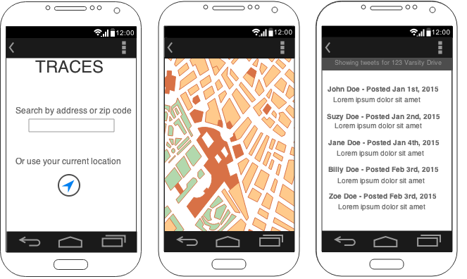
Mock Up UI Screens

Slide 10
Conclusion
Feedback on best ways to approach the UI?

